Slide 1
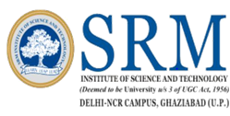

MOOCS ii
DEEP LEARNING SPECIALIZATION
Submitted by:-
RITIK DAGAR
Reg No. –RA1711003030255
B.Tech (Computer Science)

Slide 2
About this specialization
Deep Learning is one of the most highly sought after skills in tech.
In five courses, I learn the foundations of Deep Learning, understand how to build neural networks, and learn how to lead successful machine learning projects.
I learn about Convolutional networks, RNNs, LSTM, Adam, Dropout, BatchNorm, Xavier/He initialization, and more. I work on case studies from healthcare, autonomous driving, sign language reading, music generation, and natural language processing. You will master not only the theory, but also see how it is applied in industry.
AI is transforming multiple industries. After finishing this specialization, I find creative ways to apply it to your work.
This course helps me to master Deep Learning, understand how to apply it, and build a career in AI.

Slide 3
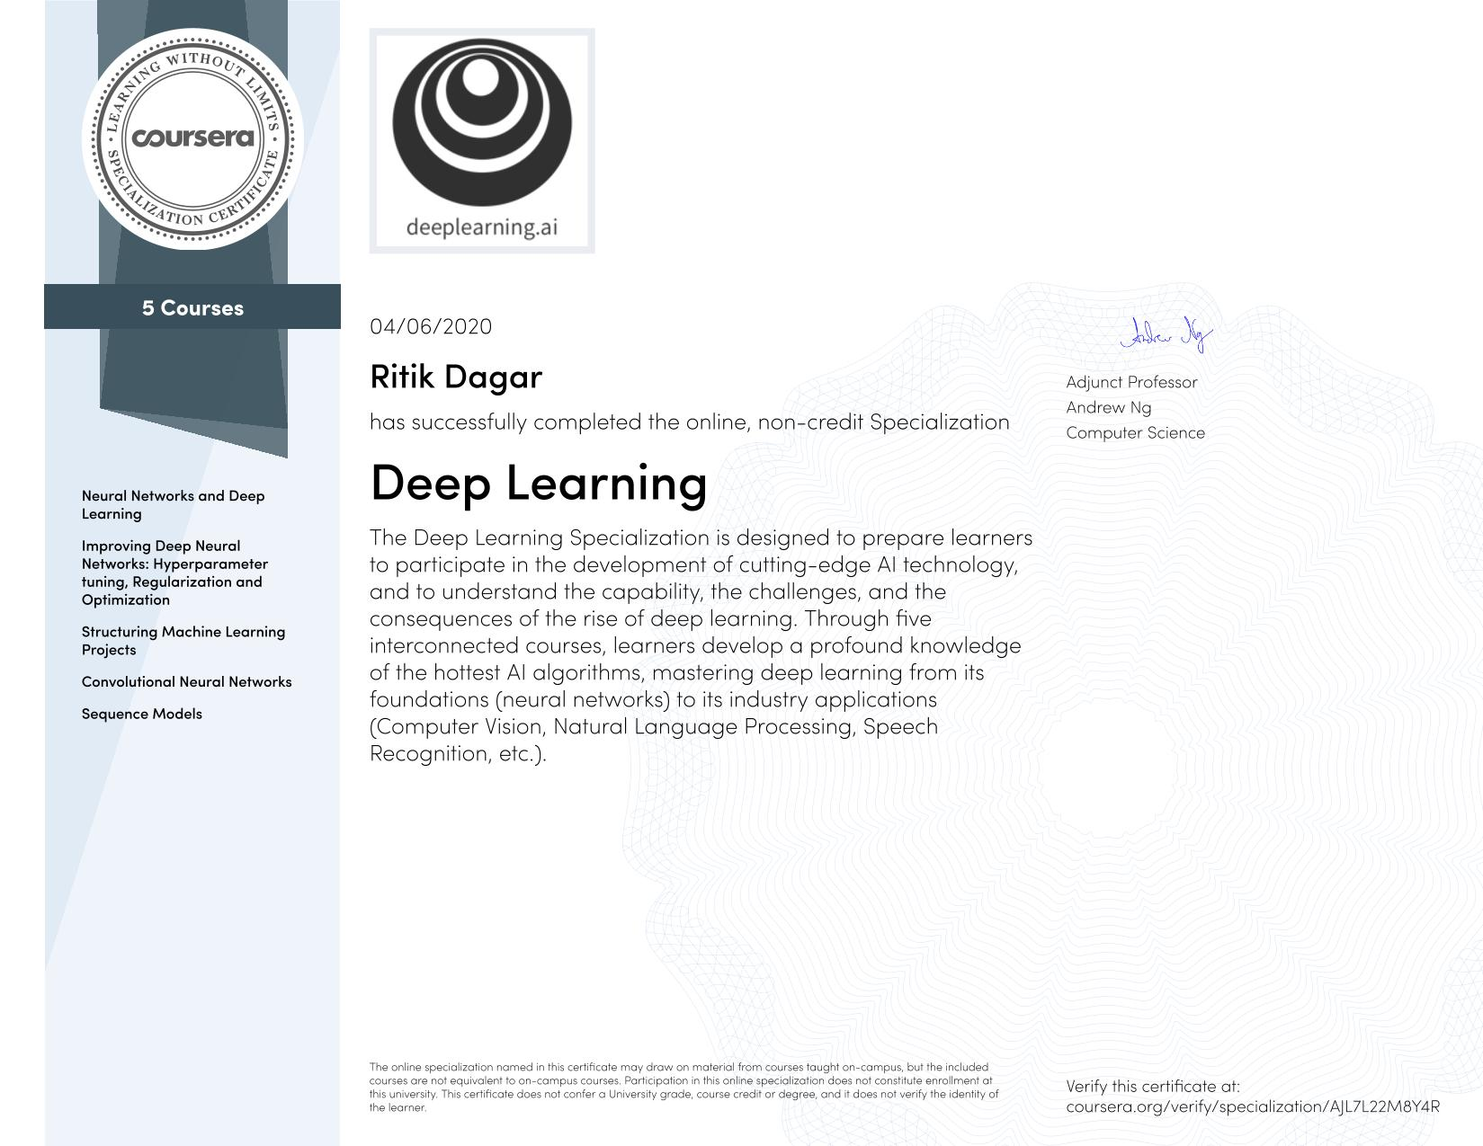
CERTIFICATE

Slide 4
Courses-
1. Neural Networks and Deep Learning
2. Improving Deep Neural Networks: Hyperparameter tuning, Regularization and Optimization
3. Structuring Machine Learning Projects
4. Convolutional Neural Networks
5. Sequence Models

Slide 5
Course 1 - Neural Networks and Deep Learning
Deep learning engineers are highly sought after, and mastering deep learning will give you numerous new career opportunities.
Deep learning is also a new "superpower" that will let you build AI systems that just weren't possible a few years ago.
In this course, I learn the foundations of deep learning. When I finish this class, I Understand the major technology trends driving Deep Learning - Be able to build, train and apply fully connected deep neural networks - Know how to implement efficient (vectorized) neural networks - Understand the key parameters in a neural network's architecture .

Slide 6
This course also teaches how Deep Learning actually works, rather than presenting only a cursory or surface-level description.
So after completing it, I am able to apply deep learning to a my own applications.
after this course you will also be able to answer basic interview questions in interview.
This is the first course of the Deep Learning Specialization.

Slide 7
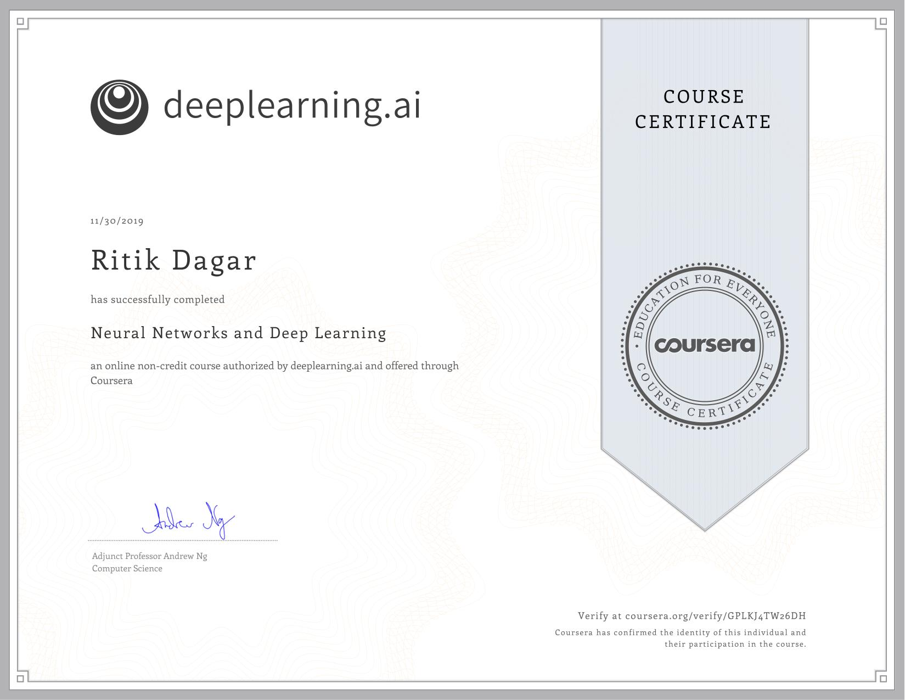
CERTIFICATE

Slide 8
Course 2 - Improving Deep Neural Networks: Hyperparameter tuning, Regularization and Optimization
This course will teach me the "magic" of getting deep learning to work well. Rather than the deep learning process being a black box, I understand what drives performance, and be able to more systematically get good results. I also learn TensorFlow.

Slide 9
After 3 weeks, I Understand industry best-practices for building deep learning applications.
I am able to effectively use the common neural network "tricks", including initialization, L2 and dropout regularization, Batch normalization, gradient checking.
I am able to implement and apply a variety of optimization algorithms, such as mini-batch gradient descent, Momentum, RMSprop and Adam, and check for their convergence.
I Understand new best-practices for the deep learning era of how to set up train/dev/test sets and analyze bias/variance - Be able to implement a neural network in TensorFlow.
This is the second course of the Deep Learning Specialization.

Slide 10
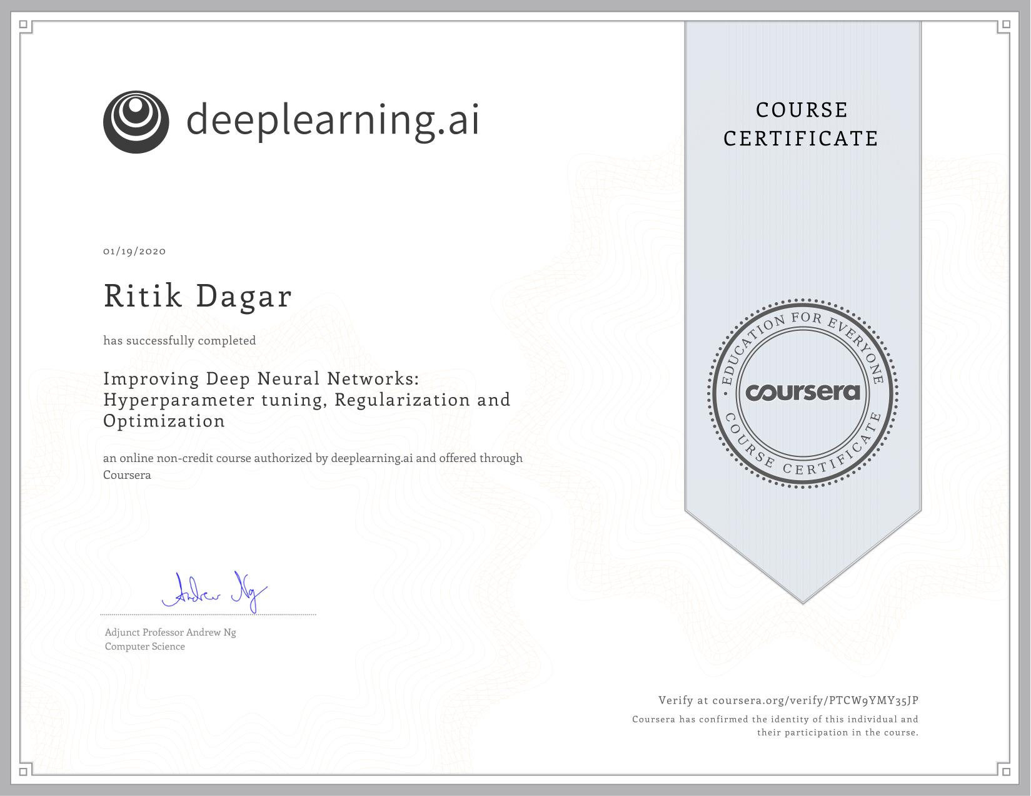
CERTIFICATE

Slide 11
Course 3 - Structuring Machine Learning Projects
In this Course I learn how to build a successful machine learning project.
If you aspire to be a technical leader in AI, and know how to set direction for your team's work, this course will show you how.
Much of this content has never been taught elsewhere, and is drawn from my experience building and shipping many deep learning products.
This course also has two "flight simulators" that let you practice decision-making as a machine learning project leader. This provides "industry experience" that you might otherwise get only after years of ML work experience.

Slide 12
After 2 weeks, I Understand how to diagnose errors in a machine learning system.
I am able to prioritize the most promising directions for reducing error .
I Understand complex ML settings, such as mismatched training/test sets, and comparing to and/or surpassing human-level performance .
I Know how to apply end-to-end learning, transfer learning, and multi-task learning I've seen teams waste months or years through not understanding the principles taught in this course.
I think this two week course will save my months of time. This is a standalone course, and you can take this so long as you have basic machine learning knowledge.
This is the third course in the Deep Learning Specialization.

Slide 13

CERTIFICATE

Slide 14
Course 4 - Convolutional Neural Networks
This course teach how to build convolutional neural networks and apply it to image data.
Thanks to deep learning, computer vision is working far better than just two years ago, and this is enabling numerous exciting applications ranging from safe autonomous driving, to accurate face recognition, to automatic reading of radiology images.
I Understand how to build a convolutional neural network, including recent variations such as residual networks.

Slide 15
I Know how to apply convolutional networks to visual detection and recognition tasks.
I Know to use neural style transfer to generate art. - Be able to apply these algorithms to a variety of image, video, and other 2D or 3D data.
This is the fourth course of the Deep Learning Specialization.

Slide 16

CERTIFICATE

Slide 17
Course 5 - Sequence Models
This course teach how to build models for natural language, audio, and other sequence data.
Thanks to deep learning, sequence algorithms are working far better than just two years ago, and this is enabling numerous exciting applications in speech recognition, music synthesis, chatbots, machine translation, natural language understanding, and many others.
I Understand how to build and train Recurrent Neural Networks (RNNs), and commonly-used variants such as GRUs and LSTMs. - Be able to apply sequence models to natural language problems, including text synthesis. -

Slide 18
I am able to apply sequence models to audio applications, including speech recognition and music synthesis.
This is the fifth and final course of the Deep Learning Specialization. deeplearning.ai is also partnering with the NVIDIA Deep Learning Institute (DLI) in Course 5, Sequence Models, to provide a programming assignment on Machine Translation with deep learning.
I have the opportunity to build a deep learning project with cutting-edge, industry-relevant content.

Slide 19

CERTIFICATE

Slide 20
Instructors
Andrew Ng
CEO/Founder Landing AI; Co-founder, Coursera; Adjunct Professor, Stanford University; formerly Chief Scientist,Baiduand founding lead of Google Brain.
Kian Katanforoosh
Lecturer of Computer Science at Stanford University, deeplearning.ai, Ecole CentraleSupelec.
Younes Bensouda Mourri
Mathematical & Computational Sciences, Stanford University, deeplearning.ai

Slide 21
THANK YOU

